Slide 1
Dhcpd buffer overrun
CVE numbers: CVE-2014-7912
Discovered by: Jüri Aedla on: 2014-11-13
Web site:
http://androidvulnerabilities.org/vulnerabilities/dhcpd_buffer_overrun

Slide 2
Attack detail
                The specific flaw exists within the parsing of the DHCP options in a DHCP ACK packet. The vulnerability is triggered when the LENGTH of an option, when added to the current read position, exceeds the actual length of the DHCP options buffer. An attacker can leverage this vulnerability to execute code on the device. This remote code execution vulnerability executes code as the dhcp user which limit's its severity [citation-needed]

Slide 3
Solution
In get_option(): don't read past the end of the option buffer.Also add a small unittest to verify sane behaviour for the above. The dhcpcd code is not easily refactored into a library, nor is it entirely possible to include some header files directly since some structures use C++ reserved keywords ("new") for variable names.
In print_option(); use of snprintf() returns the length that /would/ have been written. Add checks that the output buffer is not overrun when printing.
https://android.googlesource.com/platform/external/dhcpcd/+/73c09dd8067250734511d955d8f792b41c7213f0

Slide 4
Android WiFi-Direct Denial of Service
Andres Blanco from the CoreLabs [CWE-248]
CVE Name: CVE-2014-0997
Discovered by: 2015-01-26
Web site: https://www.exploit-db.com/exploits/35913/

Slide 5
Vulnerability Information
Class: Uncaught Exception [CWE-248]
Impact: Denial of service
Remotely Exploitable: Yes
Locally Exploitable: No

Slide 6
Vulnerable Packages
Nexus 5 - Android 4.4.4
Nexus 4 - Android 4.4.4
LG D806 - Android 4.2.2
Samsung SM-T310 - Android 4.2.2
Motorola RAZR HD - Android 4.1.2

Slide 7
Non-vulnerable packages
Android 5.0.1
Android 5.0.2

Slide 8
Vulnerability Description
Some Android devices are affected by a Denial of Service attack when scanning for WiFi Direct devices.An attacker could send a specially crafted 802.11 Probe Response frame causing the Dalvik subsystem to reboot because of an Unhandle Exception on WiFiMonitor class.

Slide 9
Vendor Information, Solutions and Workarounds
Some mitigation actions may be to avoid using WiFi-Direct or update to a non-vulnerable Android version. Contact vendor for further information.

Slide 10
Technical Description
Android makes use of a modified wpa_supplicant in order to provide an interface between the wireless driver and the Android platform framework.
Below the function that handles wpa_supplicant events. This function returns a jstring from calling NewStringUTF method.

Slide 11
static jstring android_net_wifi_waitForEvent(JNIEnv* env, jobject)
{
char buf[EVENT_BUF_SIZE];
int nread = ::wifi_wait_for_event(buf, sizeof buf);
if (nread > 0) {
return env->NewStringUTF(buf);
} else {
return NULL;
}
}

Slide 12
The WiFi-Direct specification defines the P2P discovery procedure to enable P2P devices to exchange device information, the device name is part of this information.The WifiP2pDevice class, located at
/wifi/java/android/net/wifi/p2p/WifiP2pDevice.java, represents a Wi-Fi p2p device. The constructor method receives the string provided by the wpa_supplicant and throws an IllegalArgumentException in case the event is malformed. Below partial content of the WiFiP2PDevice.java file

Slide 13
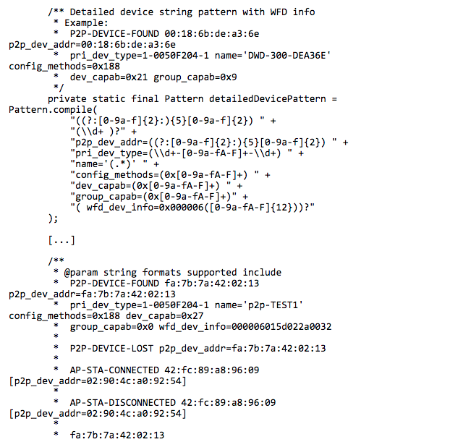

Slide 14
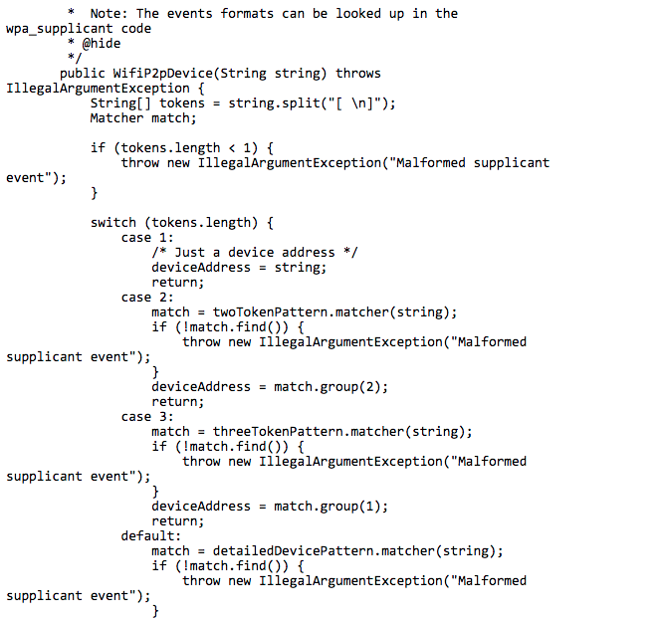

Slide 15
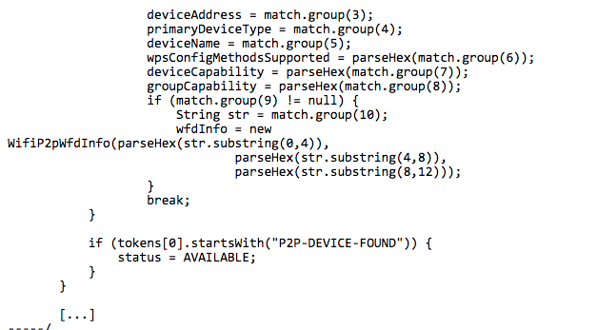

Slide 16
Samsung SM-T310 running Android 4.2.2
On some Android devices when processing a probe response frame with a WiFi-Direct(P2P) information element that contains a device name attribute with specific bytes generates a malformed supplicant event string that ends up throwing the IllegalArgumentException. As this exception is not handled the Android system restarts.

Slide 17
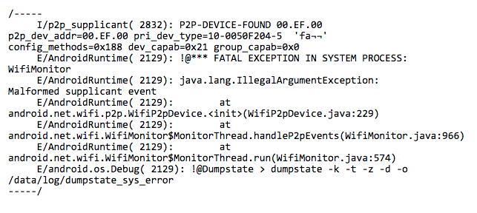

Slide 18
PChome IM 設計遭爆資訊安全問題
發表日期:2015/07/17
新聞出處:
http://www.bnext.com.tw/article/view/id/36795
http://www.bnext.com.tw/article/view/id/36798

Slide 19
多數訊息傳輸、儲存與認證金鑰並未經過適當加密
樂堤科技資深工程師 Lova 發現，PChome IM是直接以 HTTP 協定 (HTTP GET/POST)，在未經過加密協定的情況下，明文傳遞訊息。網友工程師認為，再不考慮任何其它方法的情況下，起碼應該要使用 HTTPS 的方式加密傳輸訊息。
戴夫寇爾的資訊安全顧問 Anfa Sam 則提到，PChome IM 的手機版程式，將個人聊天訊息直接以明碼的方式存在一般手機記憶卡的資料夾底下。因為記憶卡是可以讓其他 App 任意讀取的(一般而言，沒有權限管制，也不容易控制)，使用者只要透過指令提取，就可以獲得包含傳訊時間、Google或Apple Server發訊時間、送信者、收信者等等，非常詳細完整的結構化訊息資料。

Slide 20
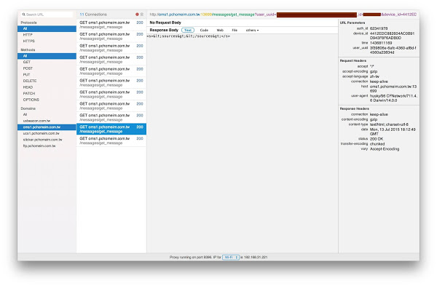

Slide 21
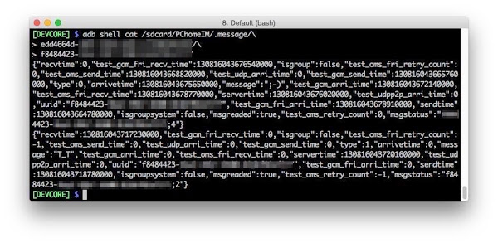

Slide 22
除了上述多數HTTP請求都沒有經過SSL加密，與所有SSL憑證密碼都是明文儲存之外，他發現 PChome IM 透過簡訊認證系統發送的帳號密碼也是明文。Zhi-Wei Cai 做了實驗，發現可以透過 PChome IM 的簡訊認證發送系統的發送過程並沒有經過 SSL 加密，所以可以輕易攔截到驗證碼，且雖然 PChome IM 的程式端已經檢查發送電話是否是台灣合法的電話號碼，但發送系統本身並沒有檢查機制。因此，惡意使用者可以輕易透過該發送系統輕易發到他國(附圖為發送系統成功發送到歐洲的電話號碼)，並且透過該簡訊偽裝為 PChome 官方進行詐騙。這中間的所有系統資訊都可能可以輕易被有心人士攔截。

Slide 23
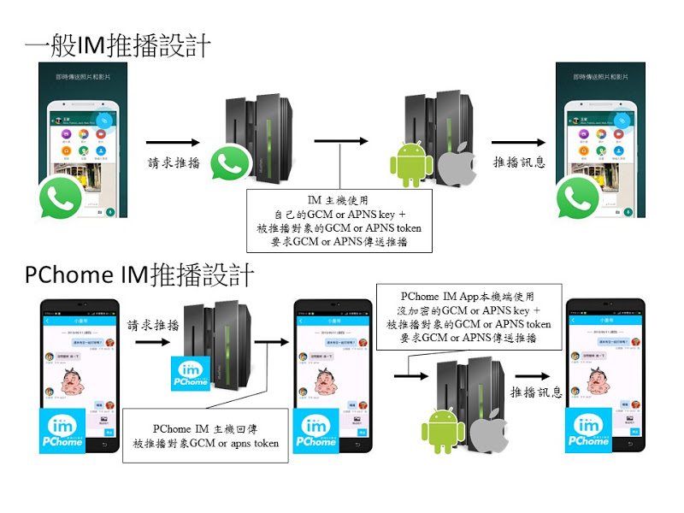

Slide 24
一般IM推播設計優點
以主機的安全性維護，來保有與 APNs 通訊所需金鑰的安 全性(不需要公開)
主機與 APNs 連接過程不會容易被發現、竊聽
由主機建立與 APNs 的連接，絕對遠比一般行動裝置所處的實體環境網路 (3G/4G/LTE/Wifi) 等的連線品質還穩定。
保障接收對象的 APNs token 不被外界輕易得知

Slide 25
PC Home推播設計缺點
裝置本機端勢必有 APNs 連線所需的認證金鑰，無論是事先儲存或當下下傳(這問題更大，還好 PChome IM 設計選擇了前者)，都比較危險。
行動裝置本身與 APNs 連接品質視行動裝置所處網路連線環境而定
APNs token 以明碼]回傳，且存於本機端裝置內。

